Slide 1

Woof
Nafis Abeer, Justin Lam, Chase Maivald, Rajiv Ramroop, Daniel Shimon

Slide 2
TABLE OF CONTENTS
01
02
03
04
Introduction
System Block Diagram
Technology/Design
KEY ACHIEVEMENTS
Problem statement, project description, requirements
Flow of information in current stage and potential future additions
Ways to leverage each section of block diagram
Here you could describe the topic of the section

Slide 3
Problem Statement
No current mainstream application catered towards just dog-owners
Prob 1
Prob3
Community
App!
Dog Friendly
Tracking
No current application exists that leverages information about dog behavior and caters to their feelings
Who would want to lose their dogs?
Prob 2

Slide 4
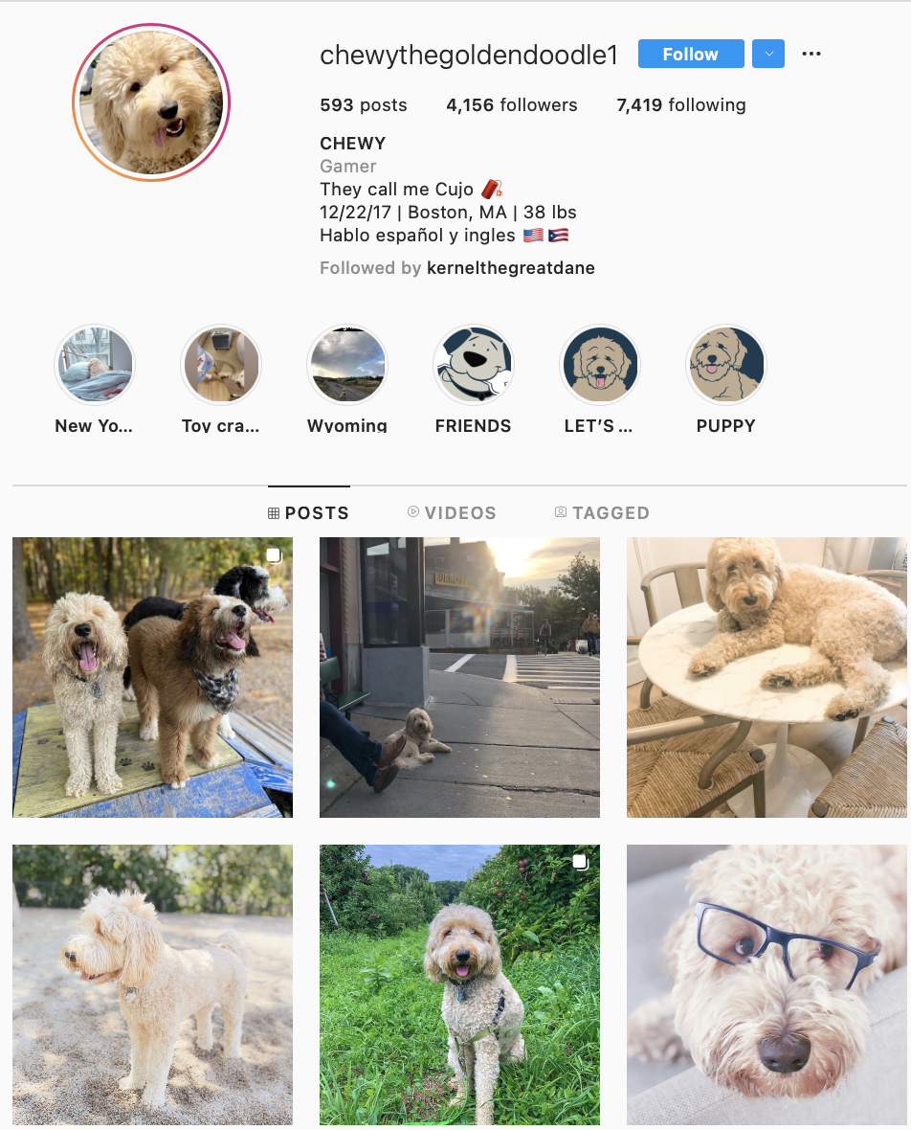
Our Project
An app where dog owners can befriend other dog owners
We stress the importance of Dogs getting along with each other
Done by collecting accelerometer and microphone data
GPS to ensure they know where their pet is
Also to relay whenever friends are visiting the park to coordinate
Similar to a social media app, with messaging and snap maps - like feature
Our client feels that the current social media applications do not offer as much functionality
Notes:
-- > mention instagram in some form to say what we currently exists and contrast how we’re different
We want to create an app where dog owners can befriend other dog owners based on the interaction their dogs have with each other. Think mix of Instagram and Snapchat, but for your dog
We want to do this by collecting accelerometer and microphone data. Using this data, we can recommend friends via each interaction.
We also want owners to be able to track their dog via GPS to ensure they know where their pet is when they aren’t around.The sensor data and GPS will be implemented on a dog tag / collar
Finally, we want our app to be similar to a social media app, where users can message their friends and create posts

Slide 5

Deliverables
Key Requirements
Dog-Maps relaying friends locations in real time
Add-Friends
Accurate friends suggestions based on dog behavior
Real time tracker for lost dog
Social media application interface
Accurate GPS information
Add friends with accurate recommendations
Recording capability for audio and accelerometer data
Sending data with modem
Authentication for read/write access to user profile information

Slide 6
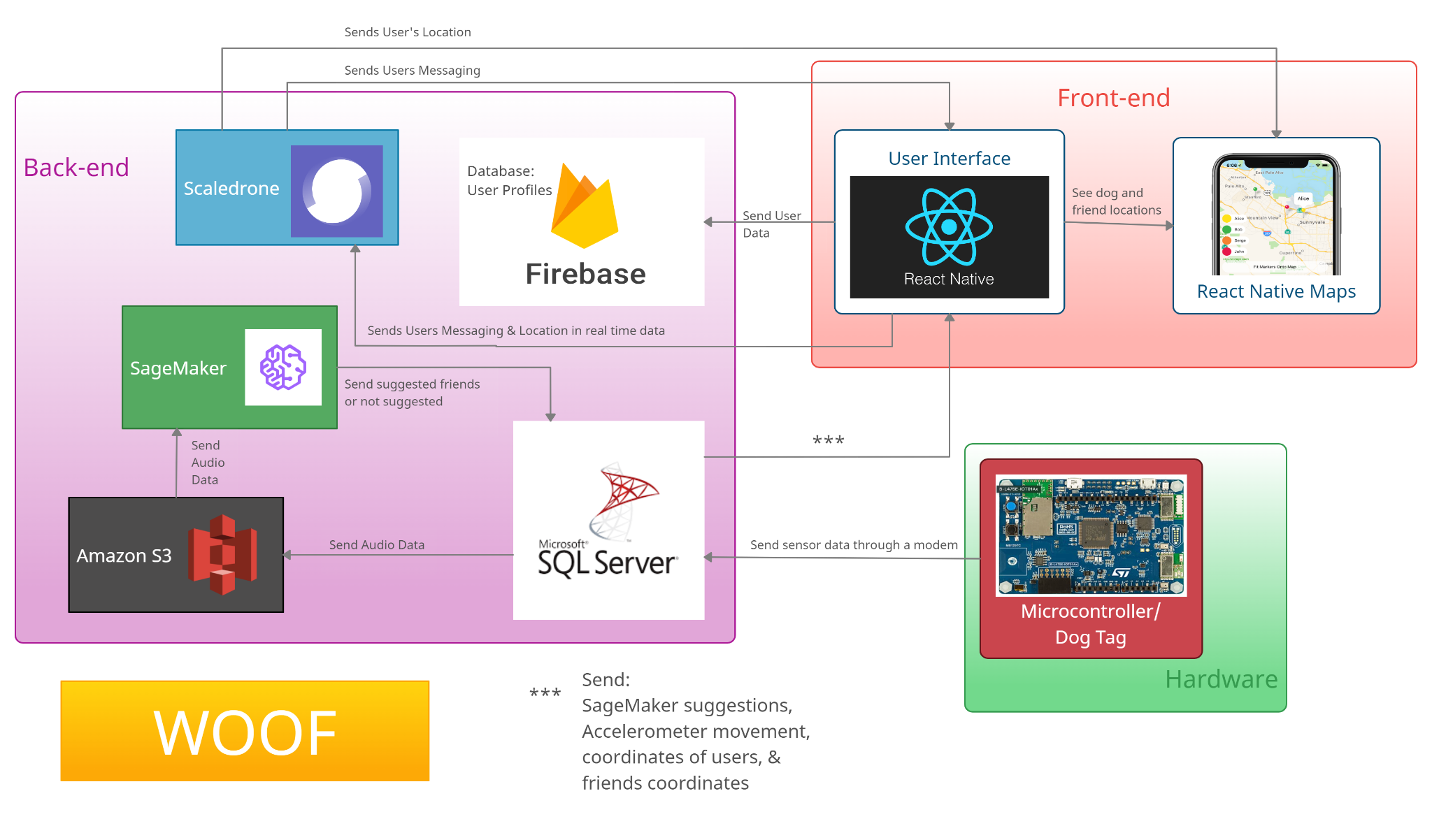
System Block Diagram

Slide 7

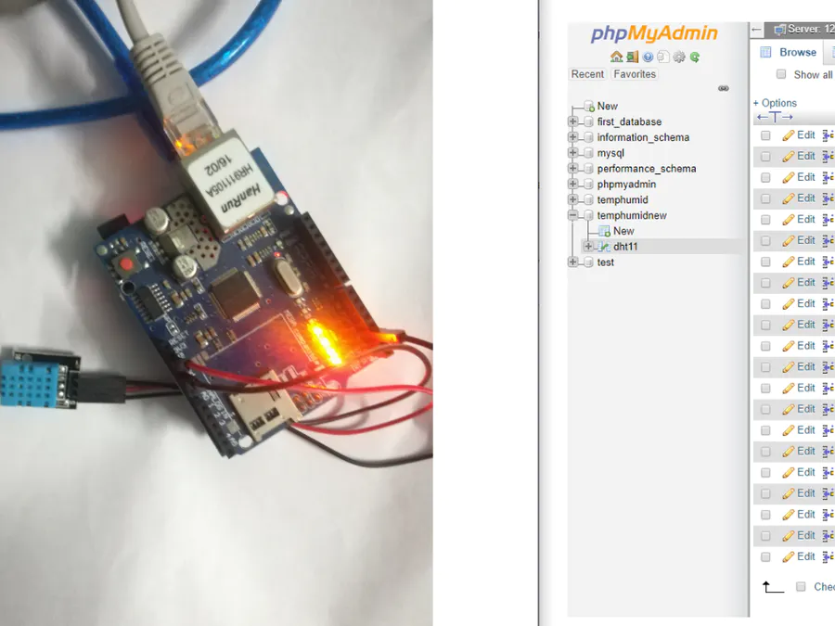
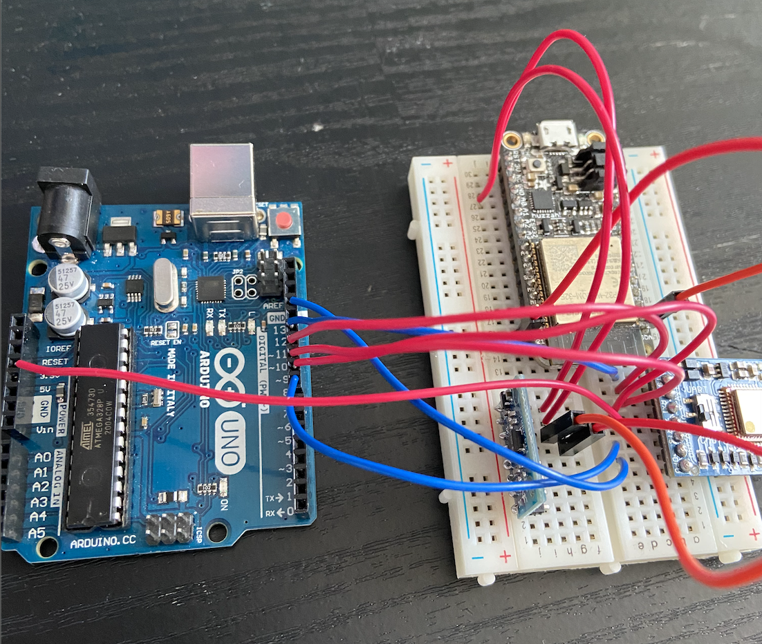
Hardware - Data collection
We will use the STM32 microcontroller for receiving accelerometer data, microphone data
This will be powered by a coin battery

Slide 8
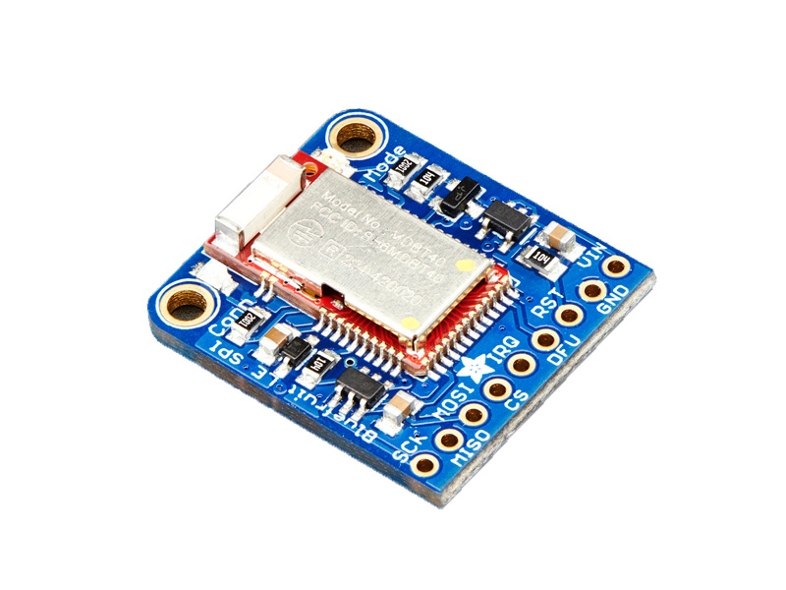
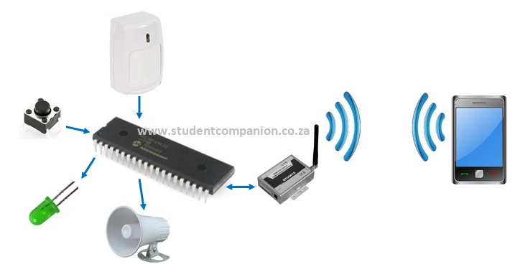
Hardware-Data Sending
When the BLE signal strength is strong, we send data
Received Signal Strength Indicator value ranges from -100 to 0
Data will be sent to SQL via IoT modem

Slide 9
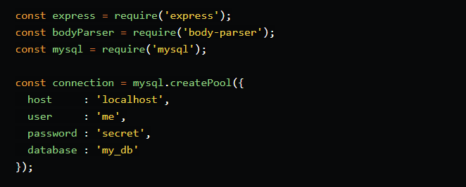
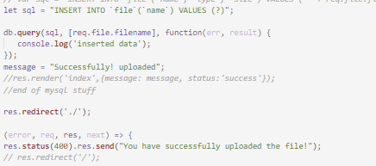
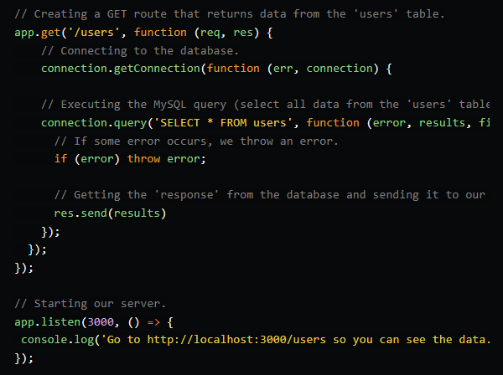
SQL Server
Reads sensor data from SQL live on React Native, writes to a file, uploads to S3
Uploading sensor data from accelerometer, microphone, location

Slide 10
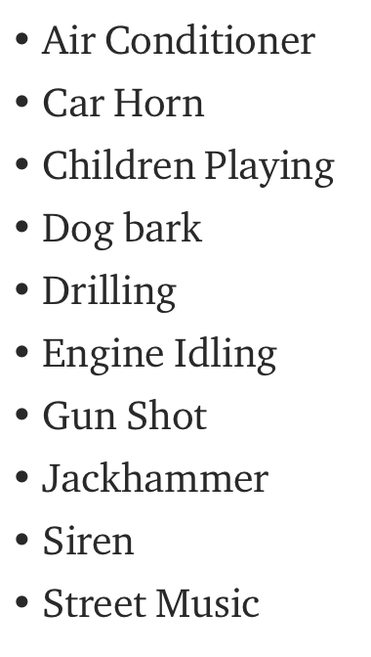
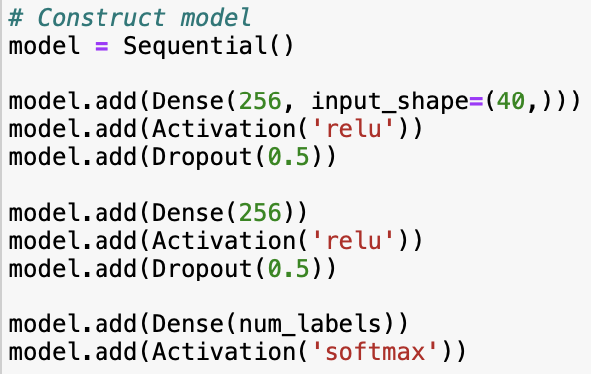
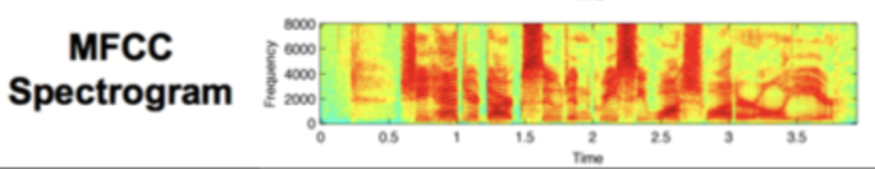
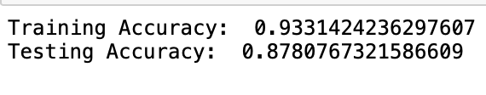
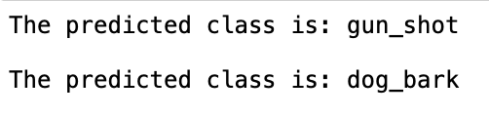
ML Model
Use Model developed this semester to detect Dog_barks in audio
Normalize audio files to have similar sample rates, bit-depths and number of audio channels
Convert audio files to spectrograms and run image processing to classify audio
Currently uses Urban-sound-8k dataset with 10 possible classes

Slide 11
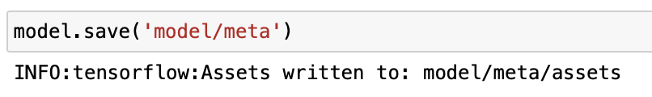
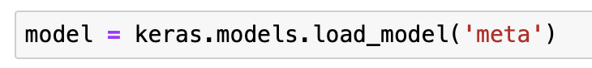
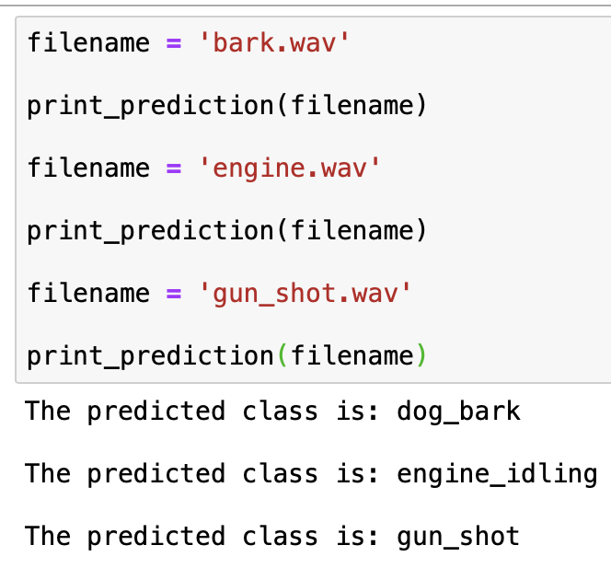
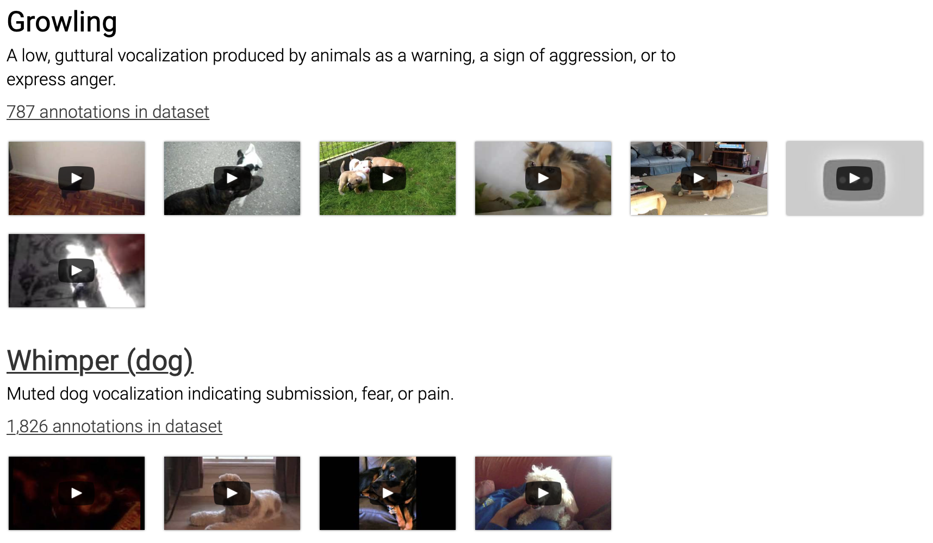
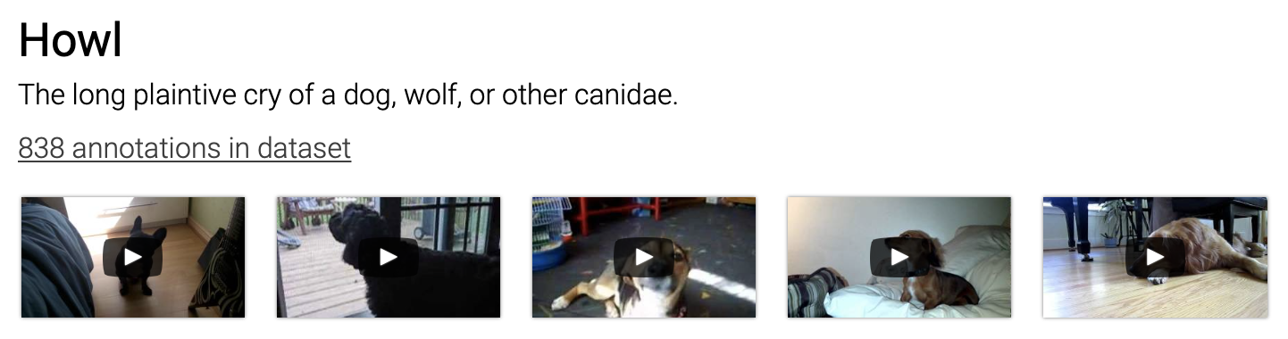
New dataset and Runtime model
Model has been saved and uploaded to amazon sagemaker
New model will be trained to classify dog barks using AudioSet data
During runtime, any new audio will be tagged with source (user) and classification of dog_bark will be sent back to SQL server to be communicated to front-end

Slide 12
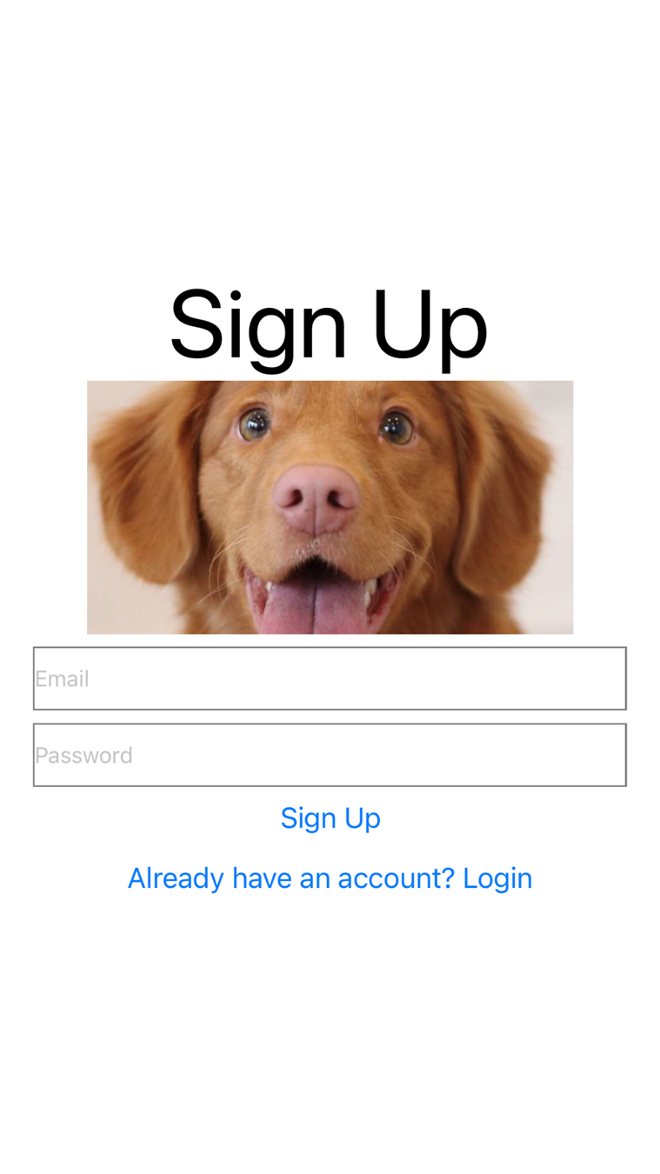
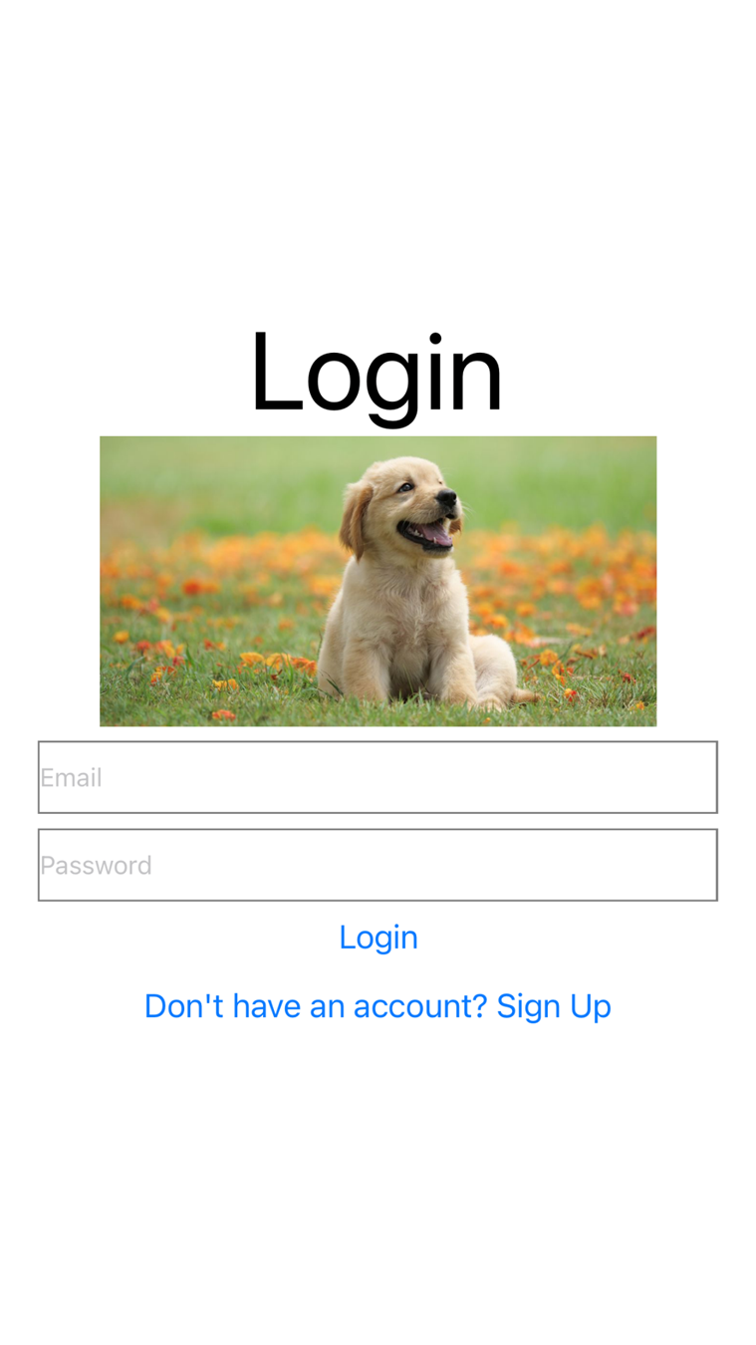
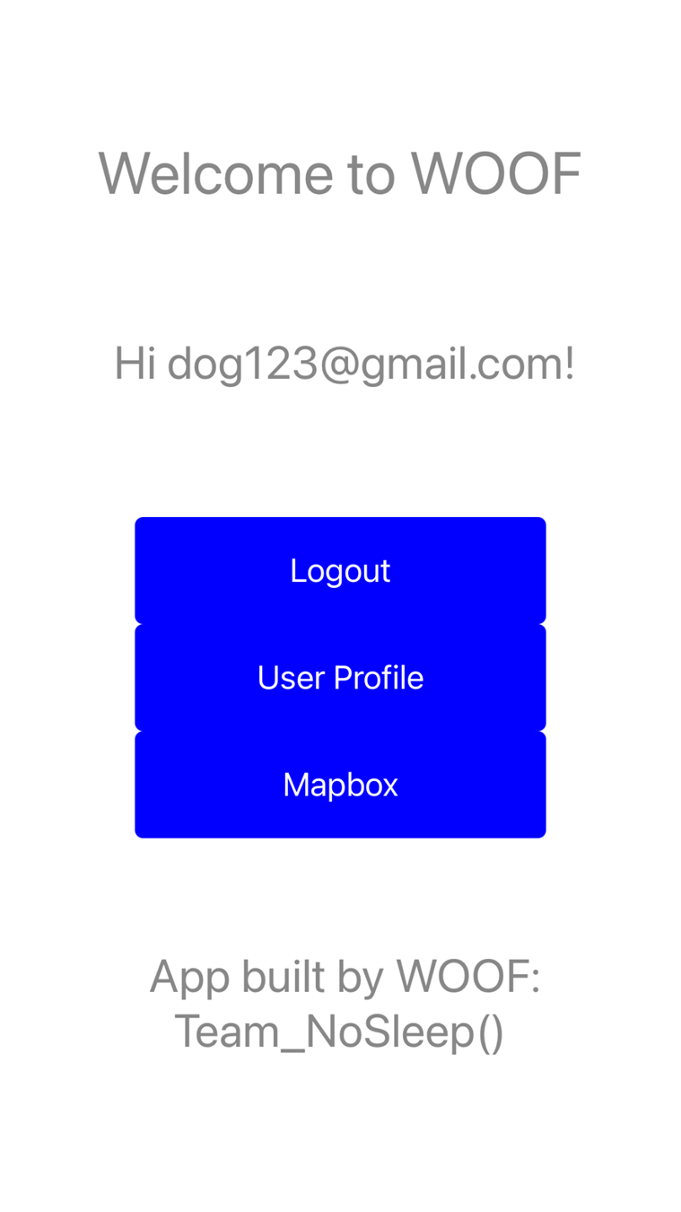
User Interface
SignUp/Login Screen
User Profile Screen
Friends/Suggestions Page
Requests/Search Page
Maps
History of Interactions
Settings

Slide 13
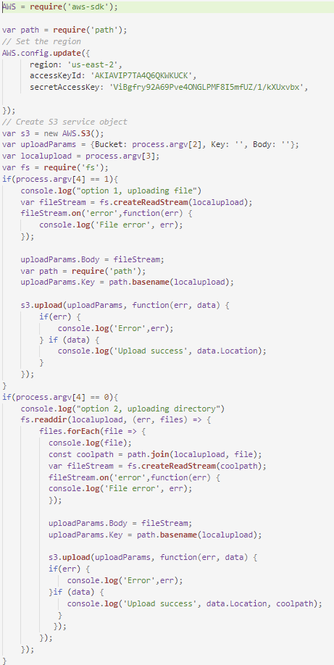
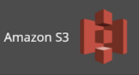
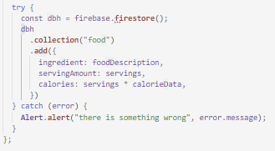

Databasing
Updates with user-profiles whenever a new user signs up for our application
Holds profile metadata for each user, like number of friends, times joined etc.

Slide 14
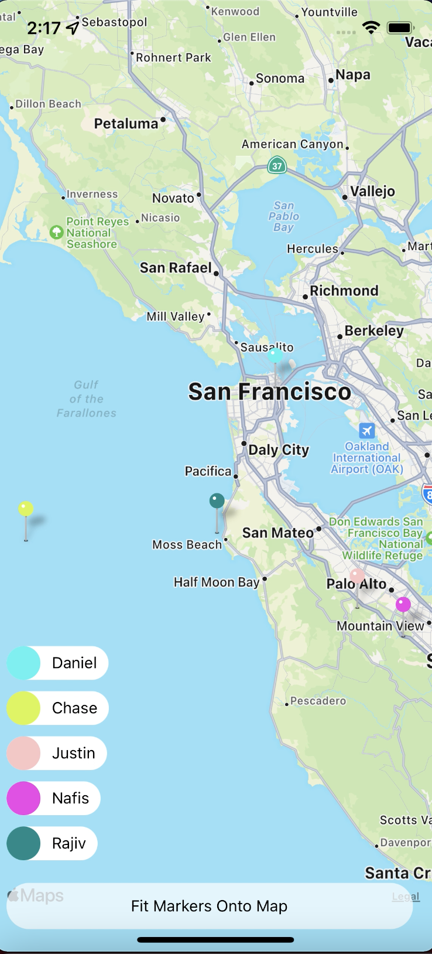
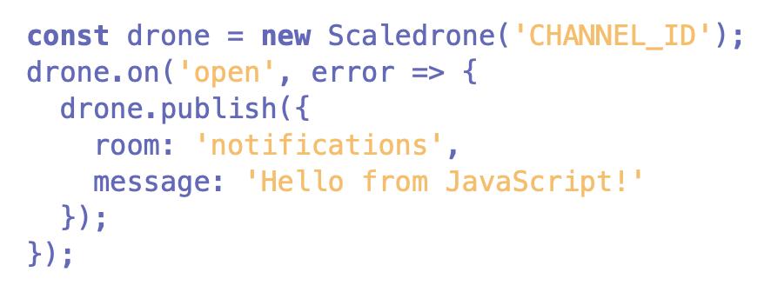
Map Component
React Native Maps
Simpler alternative to MapBox
Scaledrone
Realtime Messaging Service
Create Rooms for all Users
Chat Functionality
Location Functionality
JSON Web Token Authentication / REST API

Slide 15
Future of the Map Component
Authentication
Changing from React Native Authentication to REST Authentication
Will allow us to scale away from local server and be able to run on devices
Integrate with UI
Include user GPS data as opposed to random movements on current map

Slide 16
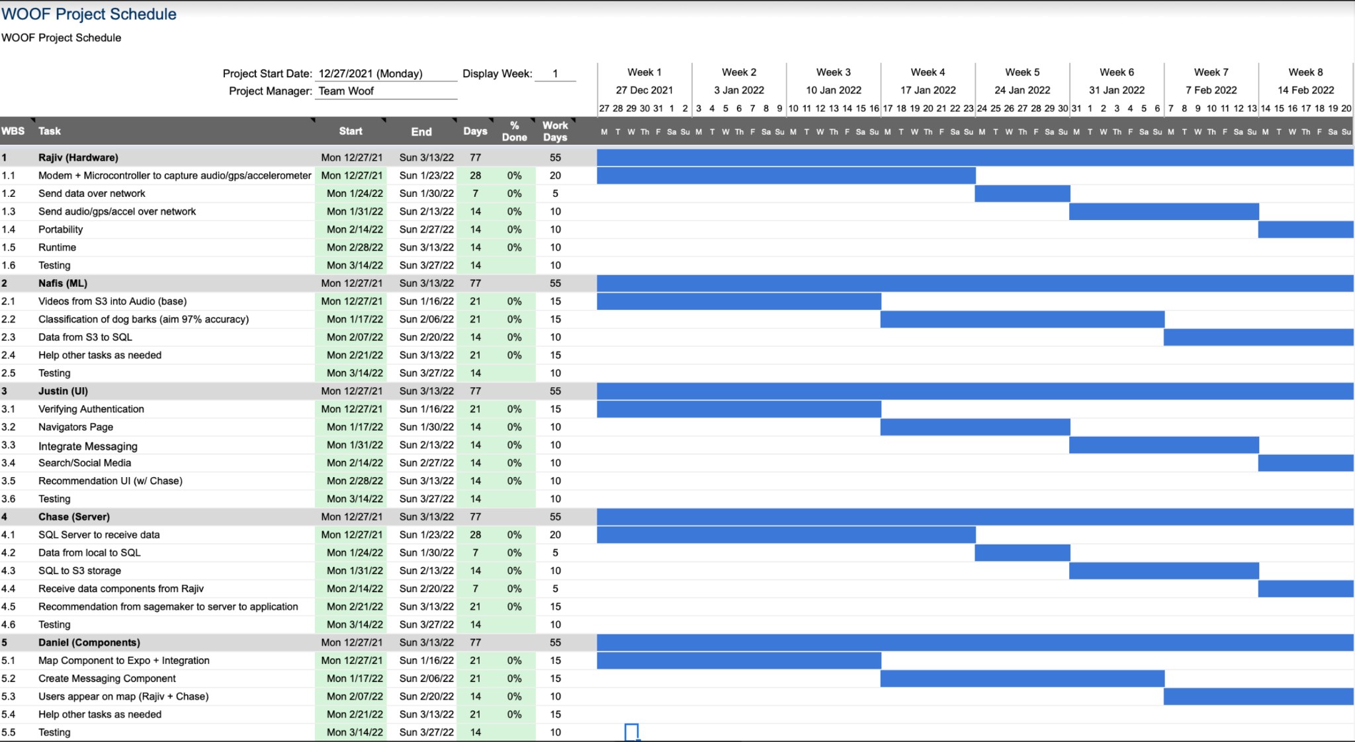
Gantt Chart

Slide 17
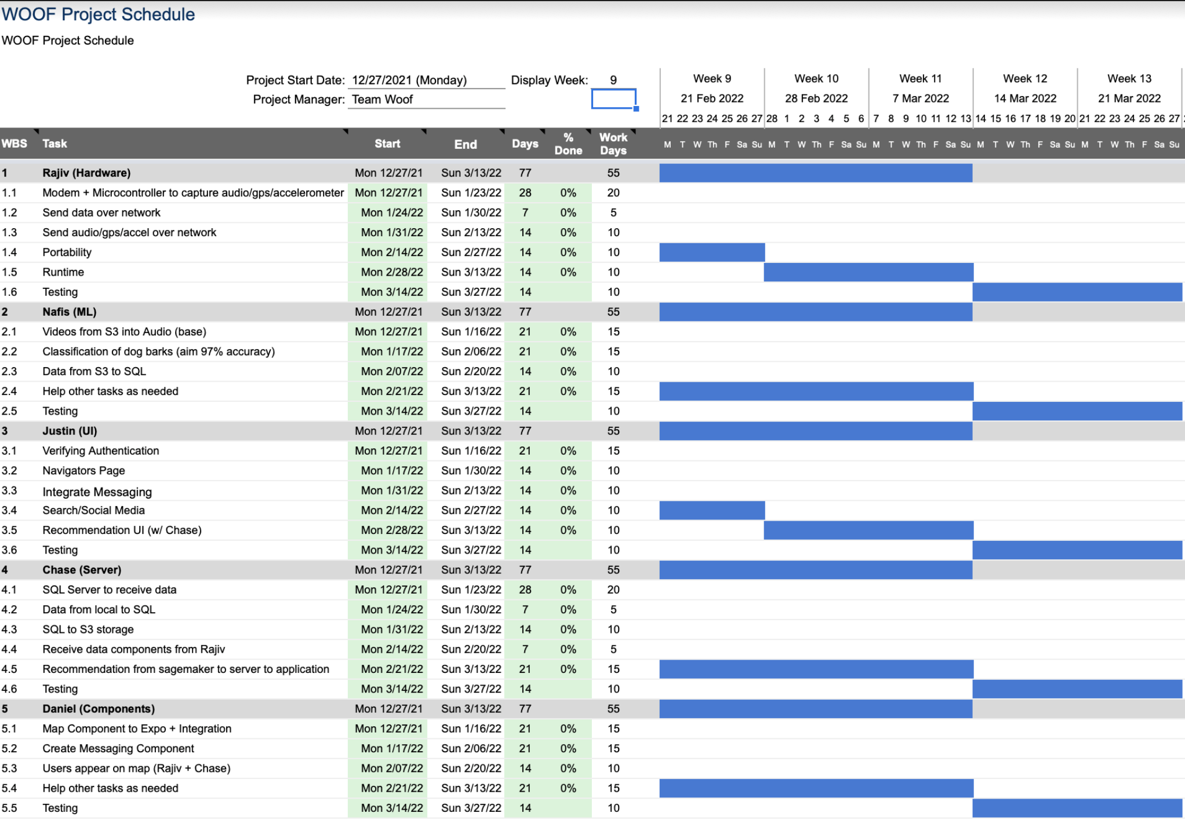
Gantt Chart (Continued)

Slide 18

Do you have any questions?
Yes

